Slide 2
“Siyenza”: PEPFAR supported re-engagement approach in South Africa
Jonathan Grund
Quality Improvement Branch Chief, Siyenza Lead, CDC South Africa
“Sticky Linkage”: Latest evidence and strategies satellite
Sunday 21 July

Slide 3
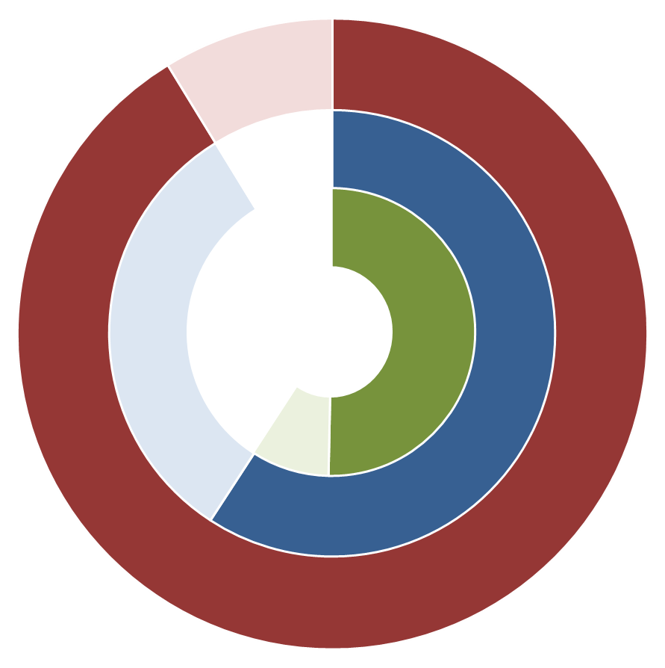
South Africa’s HIV cascade
HIV+ Status Known (6,841,203)
HIV+ Status Unknown (656,568)
HIV+ Status Known, On ART (4,437,947)
HIV+, Status Known, Not on ART (2,403,256)
On ART, Virally Suppressed (3,772,255)
On ART, Not virally Suppressed (665,692)
91%
65%
85%
 | <15 | 15+ Male | 15+ Female | Total
PLHIV* | 337,361 | 2,622,903 | 4,651,117 | 7,497,771
1st 90: Status Known* | 79% | 89% | 93% | 91%
2nd 90: ART Coverage* | 68% | 62% | 68% | 65%
3rd 90: Viral Suppression*** | 67% | 83% | 87% | 85%
* Thembisa 4.1: Johnson LF, Dorrington RE, Moolla H, (2017) Progress towards the 2020 targets for HIV diagnosis and antiretroviral treatment in South Africa, Southern African Journal of HIV Medicine,18(1): a694
*** NHLS viral load dashboard 2018

Slide 4
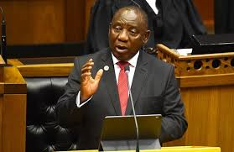
Why are we doing Siyenza?
“We remain concerned about rising HIV infections rates, particularly among young women, and the relatively low numbers of men testing for HIV and starting treatment.”
“We will intensify our work to implement the 90-90-90 strategy to end HIV as a public health threat, which includes increasing the number of people on treatment by at least another 2 million by December 2020.”
South African President Cyril Ramaphosa, State of the Nation Address, June 20, 2019

Slide 5
Why are we doing “Siyenza”?
FY19 Q1 (red circle)
Biggest drop in TX_NET_NEW in 4 quarters
FY19Q2 (green circle)
South Africa surpassed 200,000 TX_NET_NEW - a first
TX_NET_NEW results are higher than TX_NEW = improvement in retention and return of patients to care

Slide 6
Siyenza is based on “Stop, Listen, and Fix” approach
Intensive performance management at 343 high burden facilities
Implement program fundamentals well at all levels (e.g., same day initiation; trace and support return of “out of care” clients; moving stable patients into differentiated care)
Follow the data: reach men and young women with tailored programs; find and link the missing PLHIV to ART
Improve data systems and data use at all levels
Continue and optimize surge interventions
Expand engagement with Civil Society and implement People’s COP proposals

Slide 7
Siyenza’s focus on high volume facilities
Methodology
Used FY19 Q1 results from DATIM Genie
Focused on sites contributing to 40% of TX_CURR: 1,289,706
Removed hospitals (low/negative growth; transfers and down-referrals)
Ranked sites, generated site substitutions
Shared site list with the partners for input
All
PEPFAR-supported facilities (n=2,453)
100% of TX_CURR
(3,209,269)
Siyenza Focus Facilities (n=343)
40% of TX_CURR (1,289,706)

Slide 8
Siyenza relies on existing and new indicators
Metrics: TX_NET_NEW (measure for success)
Other indicators:
TX_CURR_28
HTS_TST_POS
HTS_TST_POS_IP
HTS_TST_POS_Weekend/Extended
TX_NEW_IP
TX_NEW_SAMEDAY
TX_NEW_Weekend/Extended
TX_NEW
TPT Initiated
EARLYMISSED, LATEMISSED, uLTFU
Target Assumptions
All sites need to demonstrate improvement in retention so that TX_NET_NEW = TX_NEW (100%)
All sites need to have linkage rates at or exceeding 95%:
TX_NEW/HTS_POS = 95%

Slide 9
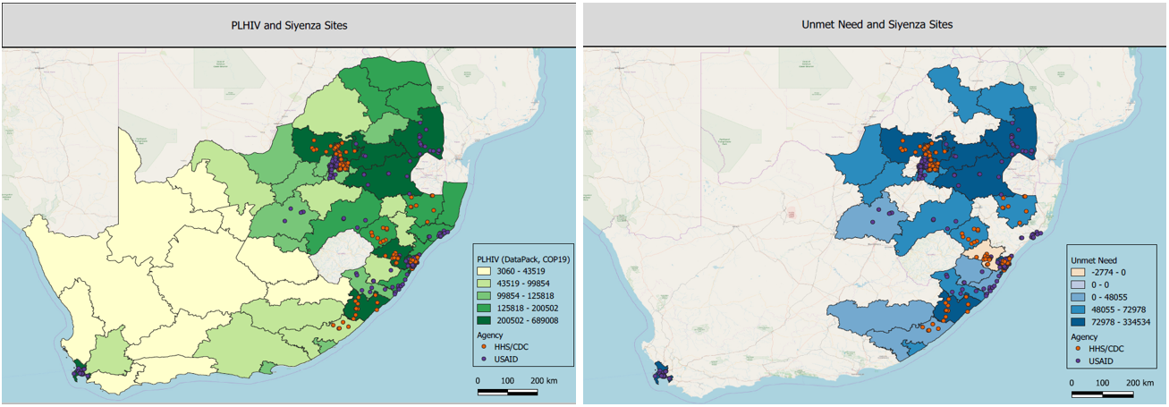
Siyenza facilities align with PLHIV and unmet need

Slide 10
Approaches for Re-Engagement – Preventing losses
SMS reminders in local languages before all appointments and within 24 hours for any missed appointments (prevent clients getting added to early-missed list)
Dedicated linkage officers at each facility
Having clients returned to care be fast-tracked upon arrival
Providing call center etiquette training for all linkage officers as patients are lost who feel linkage officers don’t have ‘manners’ or skills
Good Day. This is a message from the Staff and Manager at xxx Clinic. According to our clinic records, you missed your scheduled appointment …
Goeie dag. Dit is 'n boodskap van die Personeel en Bestuurder by xxx Clinic. Volgens ons kliniekrekords het u u geskeduleerde afspraak gemis ...
Mholweni emini nje. Lo ngumyalezo ovela kubasebenzi kunye nabaphathi kwi-XXX Clinic. Ngokwezikopi zethu zeekliniki, ulahlekile ukuqeshwa kwakho okucwangcisiweyo …

Slide 11
Approaches for Re-Engagement – Tracing
Cell phones at all facilities for SMS and phone calls
Client tracing beginning within 24 hours of missed appointment
Counselors to make after-hours calls for clients missing appts
Aligning outreach with school health teams to trace school-going defaulters
Youth ambassadors trace students at technical/vocational colleges
Community-Based Organizations for tracing
Tracers to work in their home communities
Tracers are aligned with Community Health Workers if outside their home communities

Slide 12
Approaches for Re-Engagement – Data/File Flow
Teams review files to confirm missed appointments, not data error
Use of tracking registers to trace people to a final outcome
Pre-pulling charts to know clients with appointment, also reduces waiting times
Using a “box-system” to identify client folders for clients expected to arrive each day
Confirming contact information at each visit to ensure that details are accurate to assist with future tracing, if needed

Slide 13
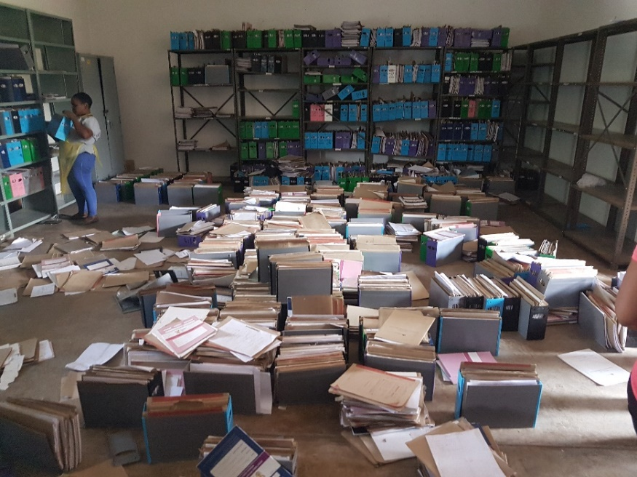
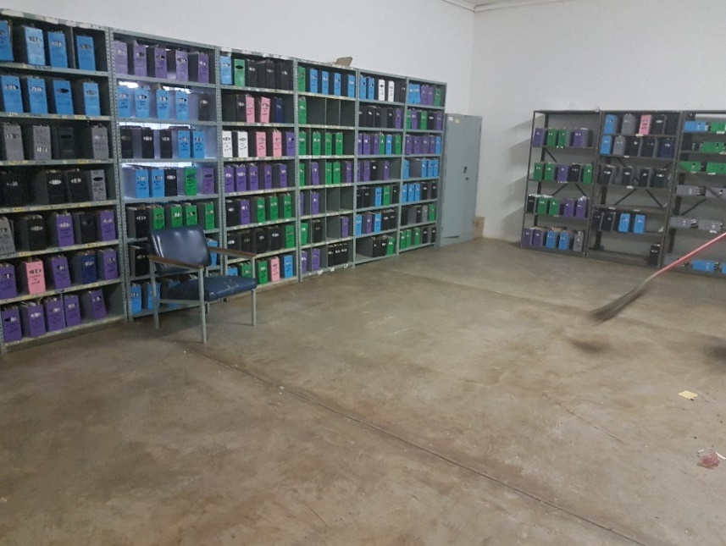
Addressing Filing at Laudium CHC in Tshwane
Before
After

Slide 14
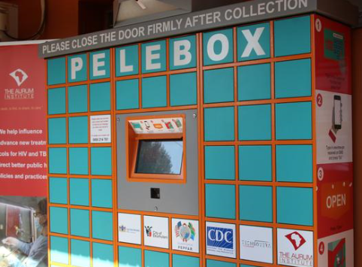
Approaches for Re-Engagement – Patient Options
I don’t like health facilities. They’re for women.
I like information from my friends or the radio because it’s in my local language.
As a HIV+ man, I just want to get my ART and then get on with my business. I have money to earn!
Offering extended and weekend hours for HIV testing and ART initiation
Providing male linkage officers and adherence counselors
Expanding internal and external pick-up points (PuPs), ART lockers, adherence clubs, etc.

Slide 15
Key Results: March – May, 2019

Slide 16
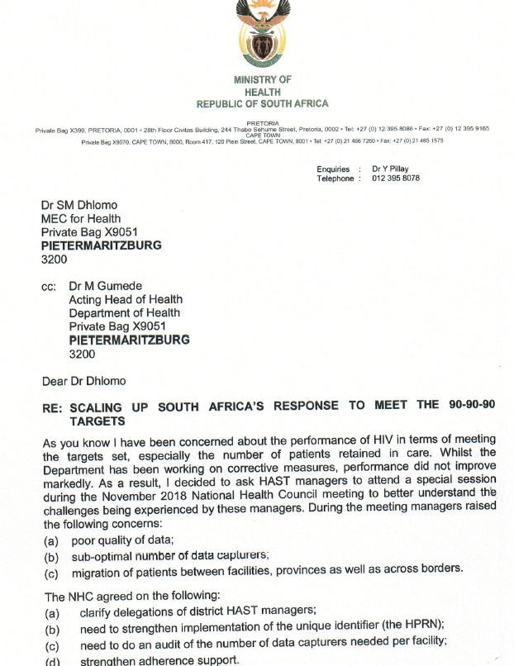
Key Drivers to Siyenza Success
National Department of Health (NDOH) Circular guided expectations for DOH staff, external PuPs, extended/weekend hours
Intensified site-level engagement by PEPFAR technical staff
Daily calls with NDOH colleagues to troubleshoot urgent issues
Partners being flexible to fill staffing gaps
Use of daily/weekly data to hold partners accountable for progress

Slide 17
Continued plans for improved retention
Deploying Case Managers to manage all new HIV positive patients for the first 12 months (until eligible for decanting)
Second NDOH circular to address current challenges
Demand creation for extended/weekend hours
Expanding patient options further:
Maximizing decanting with additional PuPs and mobile services
Targeting previous defaulted clients with a “Welcome Back” approach

Slide 18
Disclaimer
The findings and conclusions in this presentation are those of the author and do not necessarily represent the official position of the Centers for Disease Control and Prevention (CDC).

Slide 19
Acknowledgments
National, Provincial, District, and Municipal Departments of Health
CDC South Africa
USAID South Africa
PEPFAR South Africa’s Implementing Partners

